Slide 1
CS210: Computer Science II

Slide 2
Unit 2 Module 1 NS and
Separate Compilation
Separate Compilation
Namespace
Using directive
Qualifying NS
Unnamed namespace
Coding for Efficiency

Slide 3
Separate Compilation
C++ allows you to divide a program into parts
Each part can be stored in a separate file
Each part can be compiled separately
A class definition can be stored separately from a program.
This allows you to use the class in multiple programs

Slide 4
ADT Review
An ADT is a class defined to separate the interface and the implementation
All member variables are private
The class definition along with the function and operator declarations are grouped together as the interface of the ADT
Group the implementation of the operations together and make them unavailable to the programmer using the ADT

Slide 5
The ADT Interface
The interface of the ADT includes
The class definition
The declarations of the basic operations which can be one of the following
Public member functions
Friend functions
Ordinary functions
Overloaded operators
The function comments

Slide 6
The ADT Implementation
The implementation of the ADT includes
The function definitions
The public member functions
The private member functions
Non-member functions
Private helper functions
Overloaded operator definitions
Member variables
Other items required by the definitions

Slide 7
Separate Files
In C++ the ADT interface and implementation can be stored in separate files
The interface file stores the ADT interface
The implementation file stores the ADT implementation

Slide 8
A Minor Compromise
The public part of the class definition is part of the ADT interface
The private part of the class definition is part of the ADT implementation
This would hide it from those using the ADT
C++ does not allow splitting the public and private parts of the class definition across files
The entire class definition is usually in the interface file

Slide 9
Case Study: DigitalTime
The interface file of the DigitalTime ADT class contains the class definition
The values of the class are:
Time of day, such as 9:30, in 24 hour notation
The public members are part of the interface
The private members are part of the implementation
The comments in the file should provide all the details needed to use the ADT

Slide 10
Naming The Interface File
The DigitalTime ADT interface is stored in a file named dtime.hpp
The .hpp suffix means this is a header file
Interface files are always header files
A program using dtime.hpp must include it using an include directive #include "dtime.hpp"

Slide 11
#include " " or < > ?
To include a predefined header file use < and > #include <iostream>
< and > tells the compiler to look where the system stores predefined header files
To include a header file you wrote, use " and " #include "dtime.hpp"
" and " usually cause the compiler to look in the current directory for the header file

Slide 12
The Implementation File
Contains the definitions of the ADT functions
Usually has the same name as the header file but a different suffix
Since our header file is named dtime.hpp, the implementation file is named dtime.cpp
Suffix depends on your system (some use .cxx or .CPP)

Slide 13
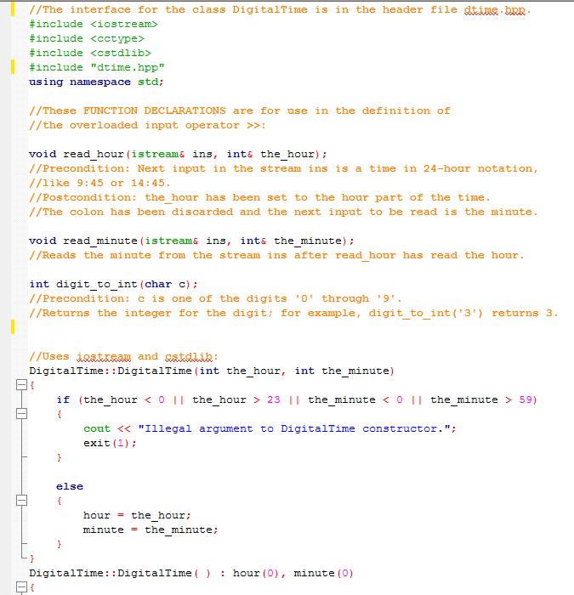
The Implementation File

Slide 14
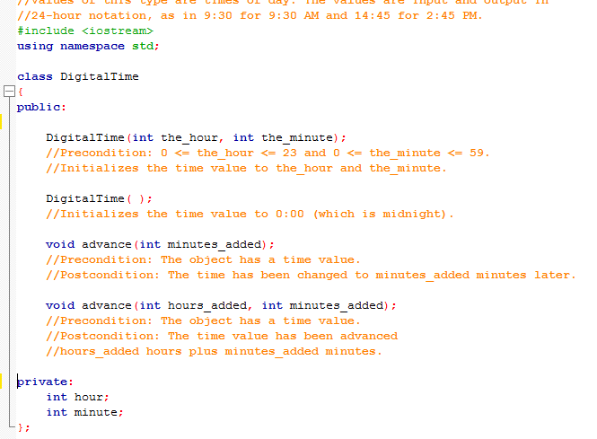
#include "dtime.hpp"
The implementation file requires an include directive to include the interface file: #include "dtime.hpp"

Slide 15
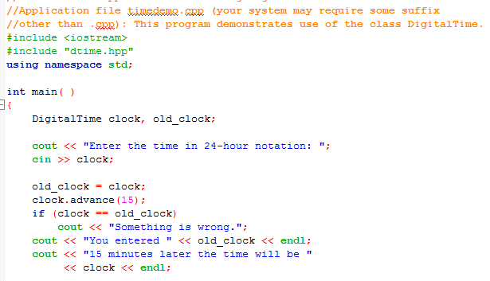
The Application File
The Application file is the file that contains the program that uses the ADT
It is also called a driver file
Must use an include directive to include the interface file: #include "dtime.hpp"

Slide 16
Running The Program
Basic steps required to run a program: (Details vary from system to system!)
Compile the implementation file
Compile the application file
Link the files to create an executable program using a utility called a linker
Linking is often done automatically

Slide 17
Compile dtime.hpp ?
The interface file is not compiled separately
The preprocessor replaces any occurrence of #include "dtime.hpp" with the text of dtime.hpp before compiling
Both the implementation file and the application file contain #include "dtime.hpp"
The text of dtime.hpp is seen by the compiler in each of these files
There is no need to compile dtime.hpp separately

Slide 18
Why Three Files?
Using separate files permits
The ADT to be used in other programs without rewriting the definition of the class for each
Implementation file to be compiled once even if multiple programs use the ADT
Changing the implementation file does not require changing the program using the ADT

Slide 19
Reusable Components
An ADT coded in separate files can be used over and over
The reusability of such an ADT class
Saves effort since it does not need to be
Redesigned
Recoded
Retested
Is likely to result in more reliable components

Slide 20
Multiple Classes
A program may use several classes
Each could be stored in its own interface and implementation files
Some files can "include" other files, that include still others
It is possible that the same interface file could be included in multiple files
C++ does not allow multiple declarations of a class
The #ifndef directive can be used to prevent multiple declarations of a class

Slide 21
Namespaces
Preceding a name by std:: indicates that the name is part of a namespace named std. A namespace is a collection of related names; the standard library uses std to contain all the names that it defines.
So, for example, the iostream standard header defines the names cout and endl, and we refer to these names as std::cout and std::endl, or class definitions and variable declarations.
If a program uses classes and functions written by different programmers, it may be that the same name is used for different things (NS help us deal with this problem)

Slide 22
Namespace std
We’ve used namespace std
Contains all names defined in all standard library files
Example: #include <iostream>
Places all name definitions (cin, cout, etc.) into std namespace
Program doesn’t know these names
Must specify this namespace for program to access names
Like blocks, namespaces define their own scopes.

Slide 23
using Directive
using namespace std;
Makes all definitions in std namespace available
Why might you NOT want this?
Can make cout, cin have non-standard meaning
Perhaps a need to redefine cout, cin
Can redefine any others

Slide 24
How to access identifiers in a namespace
#include <iostream>
int main()
{
using std::cout;
using std::endl;
cout << “Hello World!” << endl;
OR
// no using declaration
std::cout << “Hello World!”
<< std::endl;

Slide 25
How to access identifiers in a namespace
Either of these is good for our class
{
using std::cout;
using std::endl;
cout << “Hello World!” << endl;
OR
// no using declaration
std::cout << “Hello World!”
<< std::endl;
DON’T USE USING STD NAMESPACE

Slide 26
Global Namespace
The default namespace is the global one
C and pre-standardized C++
(before namespace was introduced)
No need for using directive
Global namespace always available
Implied ‘automatic’ using directive

Slide 27
Multiple Names
Multiple namespaces
e.g.: global, and std typically used
Can still use both namespaces
Must specify which namespace used at what time

Slide 28
Specifying Namespaces
Given namespaces NS1, NS2
Both have void function myFunction() defined differently
{ using namespace NS1; myFunction(); }
{ using namespace NS2; myFunction(); }
using directive has block-scope
Example: adding a function
to a namespace

Slide 29
A Subtle Point
A using directive potentially introduces a name
If ns1 and ns2 both define my_function, using namespace ns1; using namespace ns2; is OK, provided my_function is never used!

Slide 30
A Subtle Point Continued
A using declaration introduces a name into your code: no other use of the name can be made
using ns1::my_function; using ns2::my_function; is illegal, even if my_function is never used

Slide 31
Qualifying Names
Using declarations (not directives) allow us to select individual functions to use from namespaces
using ns1::fun1; //makes only fun1 in ns1 avail
The scope resolution operator identifies a namespace here
Means we are using only namespace ns1's version of fun1
If you only want to use the function once, call it like this ns1::fun1( );

Slide 32
How to access identifiers in a namespace
#include <iostream>
using std::cout;
// make all identifiers in std namespace accessible
// to the program, i.e., all functions in the program.
int main(){
cout << “Hello, World!” << endl;
return 0;
}
// undesirable for large programs

Slide 33
How to access identifiers in a namespace: continued
#include <iostream>
int main()
{
using std::cout;
// make all identifiers in std namespace accessible
// only to the main function.
cout << “Hello, World!” << endl;
return 0;
}
// better way for large programs

Slide 34
Namespaces: Using a Function
To use a function defined in a namespace
Include the using directive in the program where the namespace is to be used
Call the function as the function would normally be called int main( ) { { using namespace savitch1; greeting( ); }
Using directive's scope

Slide 35
Qualifying Parameter Names
To qualify the type of a parameter with a using declaration
Use the namespace and the type name
int get_number(std::istream input_stream)
istream is the istream defined in namespace std

Slide 36
Unnamed Namespaces
As we have done helper functions so far, they are not really hidden
We would like them to be local to the implementation file to implement information hiding
The unnamed namespace can hide helper functions
Names defined in the unnamed namespace are local to the compilation unit
A compilation unit is a file (such as an implementation file) plus any file(s) #included in the file

Slide 37
The unnamed grouping
Every compilation unit has an unnamed namespace
The namespace grouping is written as any other namespace, but no name is given: namespace { void sample_function( ) … } //unnamed namespace

Slide 38
Names in The unnamed namespace
Names in the unnamed namespace
Can be reused outside the compilation unit
Can be used in the compilation unit without a namespace qualifier
The idea is that the items can be "global" to the source file they are in, but not pollute the namespace of any other source files in your compilation.

Slide 39
Names in The unnamed namespace
namespace
{
//These function declarations are for use …
void read_hour(istream& ins, int& the_hour);
//Precondition: Next input in the stream ins …
//Postcondition: the_hour has been set …
void read_minute(istream& ins, int& the_minute);
//Reads the minute from the stream ins after read_hour…
int digit_to_int(char chToDigit);
//Precondition: c is one of the digits '0' through '9'.
//Returns the integer for the digit; for example, ...
}//unnamed namespace

Slide 40
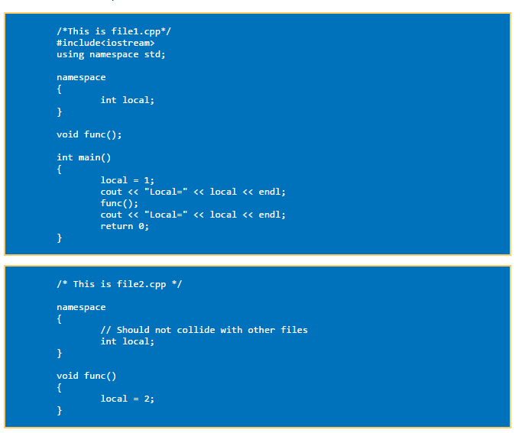
Cont…The unnamed NS
The result of this program will be:
Local = 1
Local = 1

Slide 41
Compilation Units Overlap
A header file is #included in two files
It is in two compilation units
Participates in two unnamed namespaces!
This is OK as long as each of the compilation units makes sense independent of the other
A name in the header file's unnamed namespace cannot be defined again in the unnamed namespace of the implementation or application file

Slide 42
Global or unnamed?
Names in the global namespace have global scope (all files)
They are available without a qualifier to all the program files
Names in the unnamed namespace are local to a compilation unit
They are available without a qualifier within the compilation unit

Slide 43
NS Efficiency?
There is no cost in terms of execution speed to using namespaces.
Namespace usings are for your convenience, not for you to inflict on others: Never write a using declaration or a using directive before an #include directive.
In header files, don’t write namespace-level using directives or using declarations; instead, explicitly namespace-qualify all names.
You can and should use namespace using declarations and directives liberally in your implementation files

Slide 44
Make functions local
A function that is used only within the same module (i.e. the current .cpp file) should be made local. This makes it easier for the compiler to inline the function and to optimize across function calls. There are three ways to make a function local, but we offer the best one:
Put the function or class into an anonymous namespace

Slide 45
Put all entities with linkage in implementation files.
We may defined NS as seen (in our driver app):
namespace
{
// Constants
const double DEATH_RATE = 0.1;
const double CONVERSION_RATE = 0.00001;
const double GROWTH_RATE = 0.4;
const double WOLF_ABILITY = 0.0005;
const int CAPACITY = 30000;
const int ARRAY_SIZE = 101;
}

Slide 46
Put all entities with linkage in implementation files.
First, what is linkage?
linkage describes how names can or can not refer to the same entity throughout the whole program or a single translation unit.
We want same names in our program. We saw (or would see) pretty quickly how these names defined this way are not seen in our functions.
We’ll be tempted to recreate them in our header files. We then may encounter messages and cause link-time errors complaining of duplicate symbols… That’s because each source file actually defines and allocates space for them.
This causes bloat because they are repeated.

Slide 47
Put all entities with linkage in implementation files.
For our program we will want to use the extern option, accompanied with a separate implementation file (.hpp)
Programmer’s use extern to extend the visibility. We will code them in main, as a forward declaration (here are the names that will be used later…)
This avoids having many copies by sharing these constants. We need to simply add the extern, and make a separate header file (see p3Constants) to hold only the variable forward declarations

Slide 48
Put all entities with linkage in implementation files.
And here is the updated NS now as seen:
namespace p3Constants (in our driver app)
{
// Constants
extern const double DEATH_RATE = 0.1;
extern const double CONVERSION_RATE = 0.00001;
extern const double GROWTH_RATE = 0.4;
extern const double WOLF_ABILITY = 0.0005;
extern const int CAPACITY = 30000;
extern const int ARRAY_SIZE = 101;
}

Slide 49
Put all entities with linkage in implementation files.
#ifndef p3Constants_hpp
#define p3Constants_hpp
// This header file is just for forward declarations of the variables.
// A forward declaration tells the compiler about the existence
// of these constants before actually defining them...
namespace p3Constants{
// Project 3 Constants
extern const double DEATH_RATE;
extern const double CONVERSION_RATE;
extern const double GROWTH_RATE;
extern const double WOLF_ABILITY;
extern const int CAPACITY;
extern const int ARRAY_SIZE;
}
#endif

Slide 50
Put all entities with linkage in implementation files.
A look inside of the p3Population function, we find the include for the constants (b/c it was the first to use them):
#ifndef p3Population_hpp
#define p3Population_hpp
Constants will get instantiated only once (in p3Constants.hpp),
instead of once every time p3Constants.hpp is #included, and
the other uses will simply refer to the version in P3WolfMoose.cpp.
#include "p3Constants.hpp"
using namespace p3Constants;

Slide 51
Q & A
Explain the purpose of using interface and implementation files?
Describe a namespace?
Demonstrate three ways to use the names in a namespace?

Slide 52
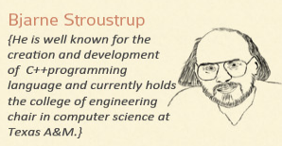
End
You could create an alias for a namespace too, like this: namespace lost = found. Now lost is found….

Slide 53
References
Slide contributions include:
Walter Savitch, Problem solving with C++ (9th Edition). Addison-Wesley Longman Publishing Co., Inc. Boston, MA, USA ©2015
Gaddis, Starting Out with C++: From Control Structures through Objects, (8th Ed.) , Addison-Wesley Longman Publishing Co., Inc. Boston, MA, USA ©2015
Bjarne Stroustrup, The C++ Programming Language, 3rd Edition, Addison-Wesley Longman Publishing Co., Inc. Boston, MA, USA ©2007
Herb Sutter, Andrei Alexandrescu, C++ coding standards : 101 rules, guidelines, and best practices, Copyright © 2005 Pearson Education, Inc.
Paul Deitel & Harvey Deitel, C++ How to Program, (7th Ed.) © 2010 by Pearson Education, Inc.
Upper Saddle River, New Jersey 07458
Scott Meyers, Effective Modern C++. Copyright © 2015 (O’Reilly) , 978-1-491-90399-5.
Andrew Koenig and Barbara E. Moo, Accelerated C++ Practical Programming by Example,
Addison-Wesley, 2000 ISBN 0-201-70353-X

Slide 54
References
Slide contributions include:
Frank M. Carrano. Data Abstraction & Problem Solving with C++ (5th Edition)
Addison-Wesley Longman Publishing Co., Inc. Boston, MA, USA ©2006
TutorialsPoint - http://www.tutorialspoint.com/cplusplus/
Cplusplus.com - http://www.cplusplus.com/doc/tutorial/

